Slide 1



Nexus C&V
15423 - Pushkar Deepankar
15425 - Samarth Birdawade

Slide 2
Index
Introduction
Objective
Future Scope
System &
Form Design
Bibliography

Slide 3
Introduction
Nexus C&V: A Dynamic Coupon Marketplace. We source coupons and vouchers from various organizations, connecting businesses with cost-conscious consumers. Save on everyday purchases, or expand your reach as a business. Nexus C&V - Unlock Savings and Growth.
3

Slide 4

Future Scope
Financial Viability Analysis
Legal and Ethical Compliance
User Feedback Integration
Future Growth Recommendations
4

Slide 5

Platform Development Coupon Sourcing Strategies Operational Workflow User Experience Enhancement
Objectives

Slide 6
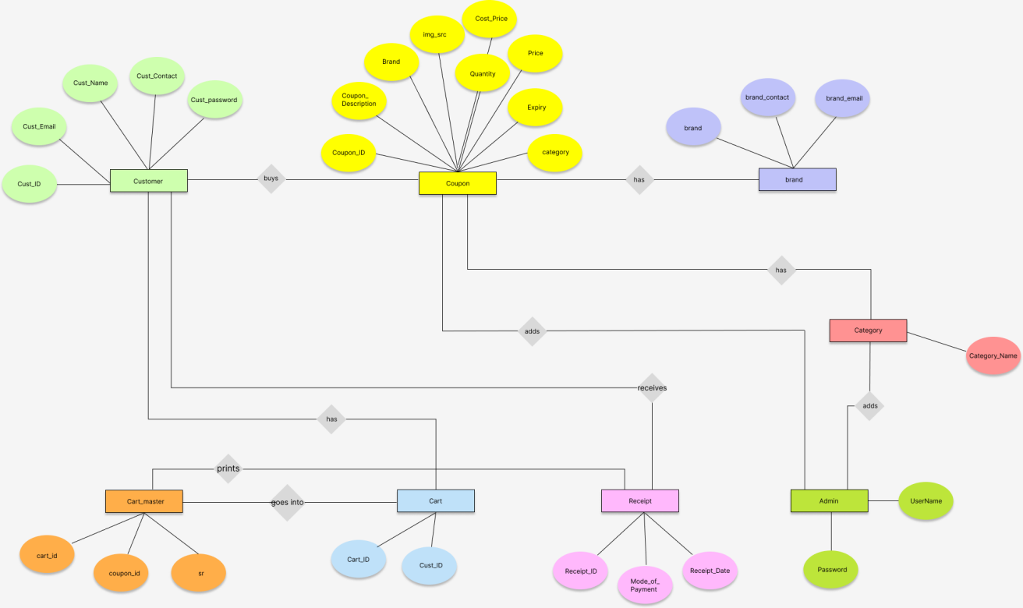
System Design
6

Slide 7
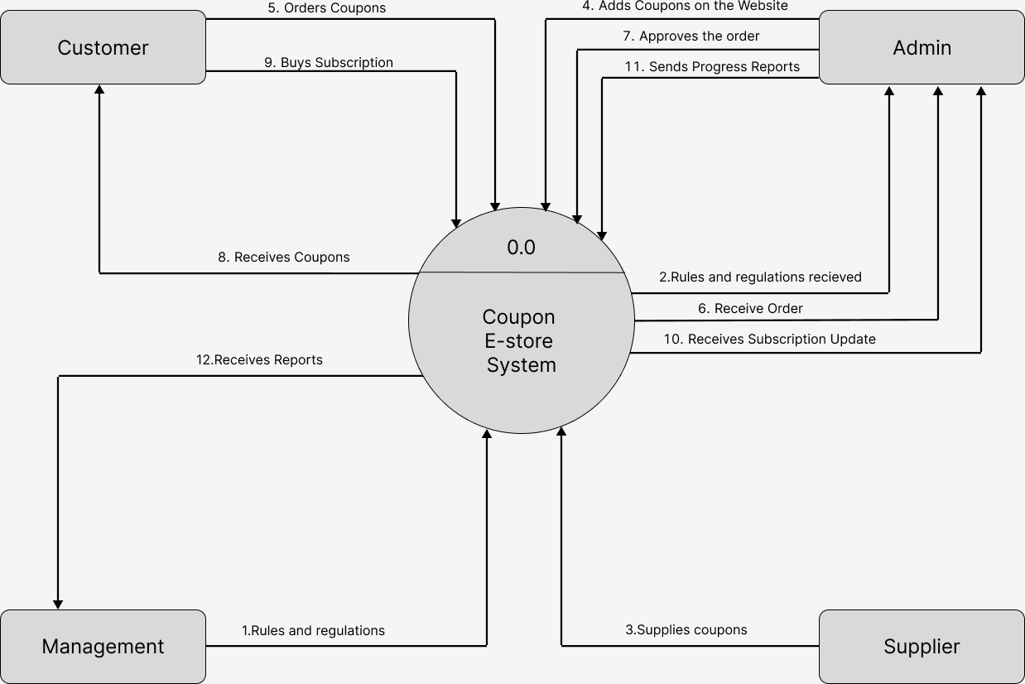
System Design
7

Slide 8
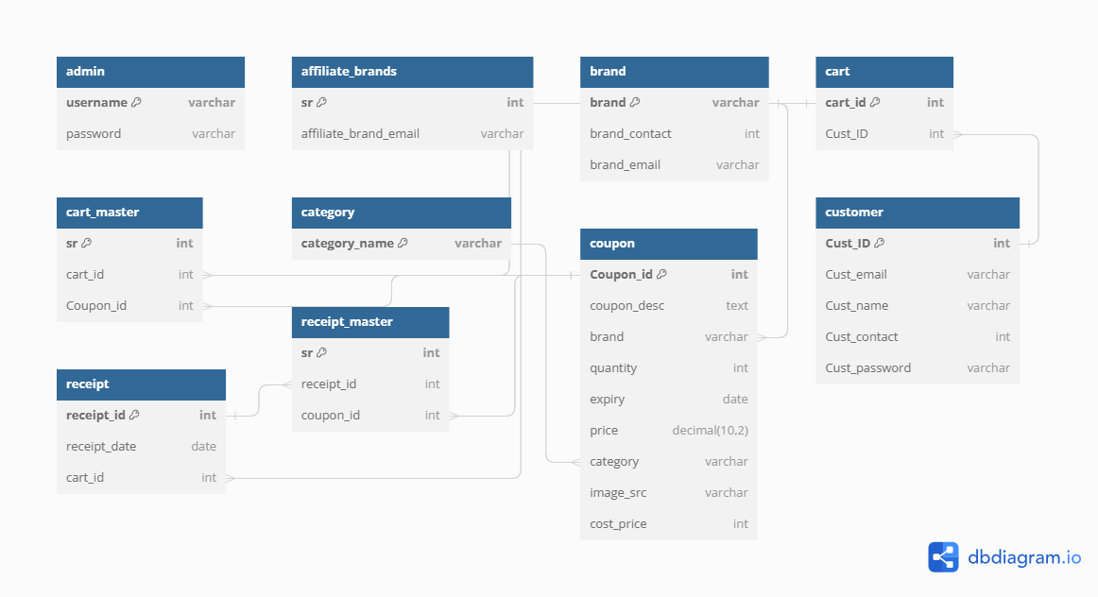

System Design
8

Slide 9

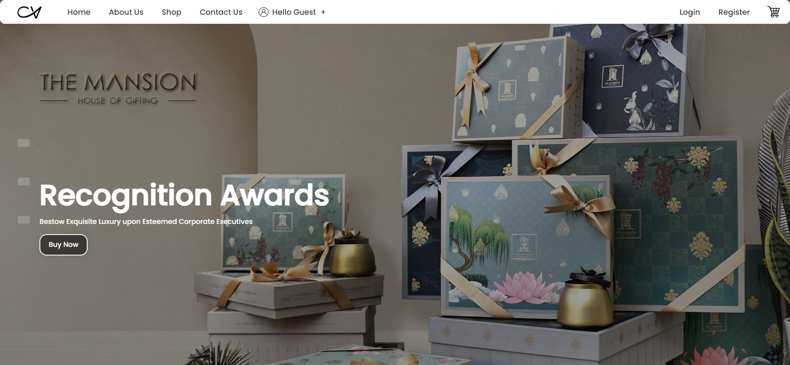

Slide 10
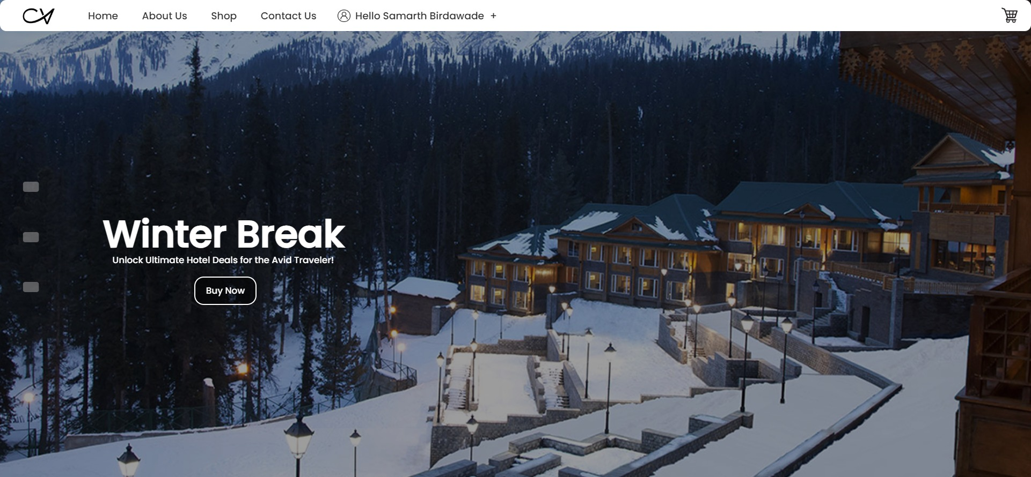

Slide 11
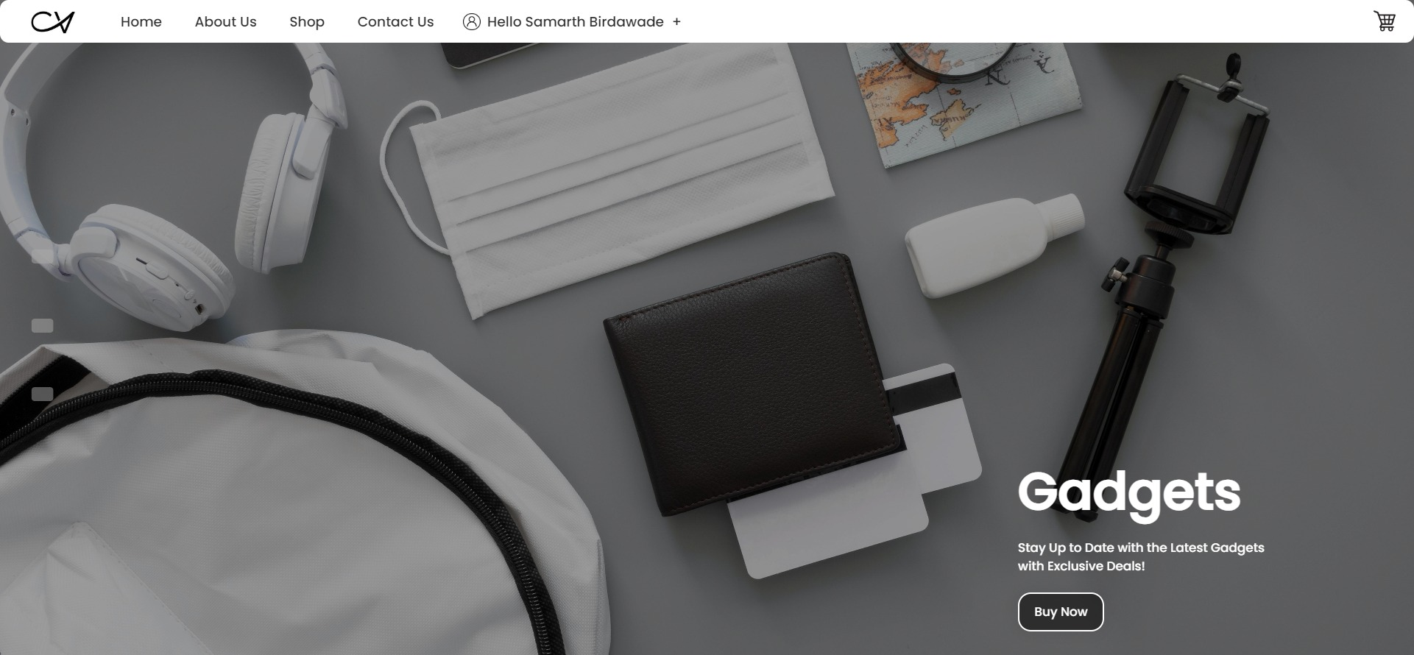

Slide 12


Slide 13
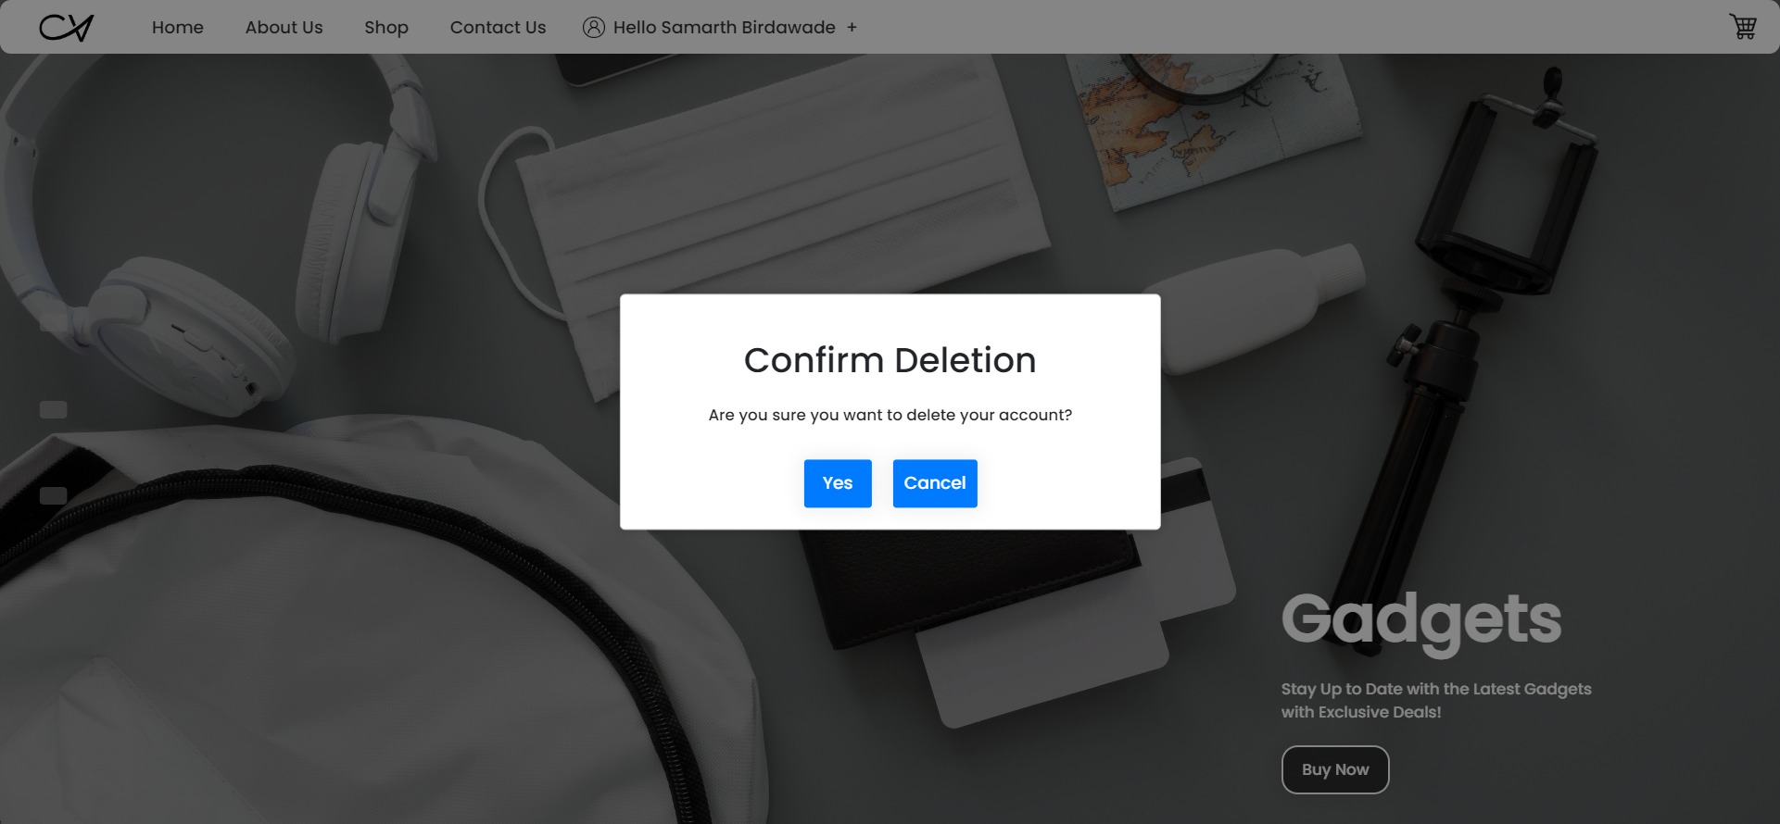

Slide 14
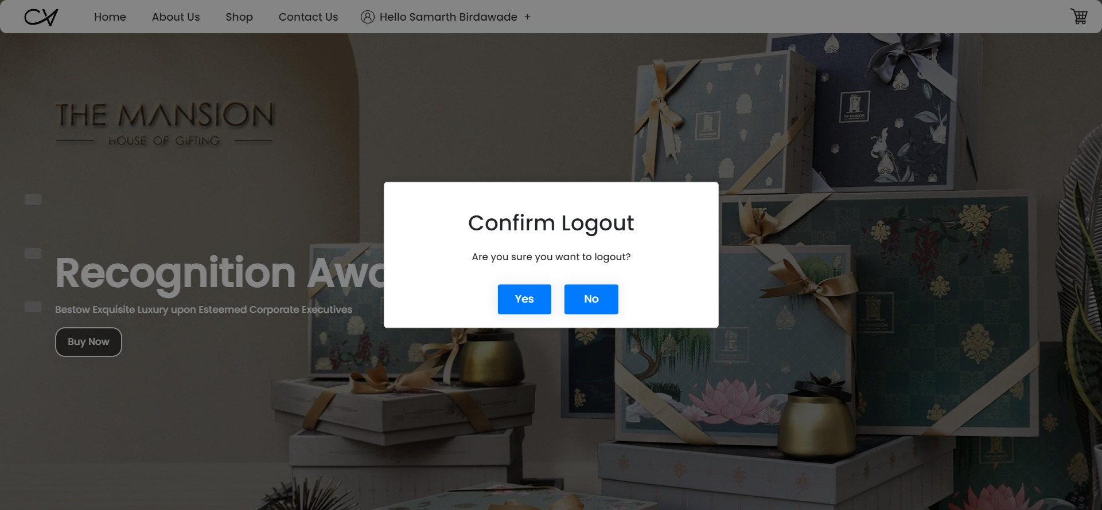

Slide 15
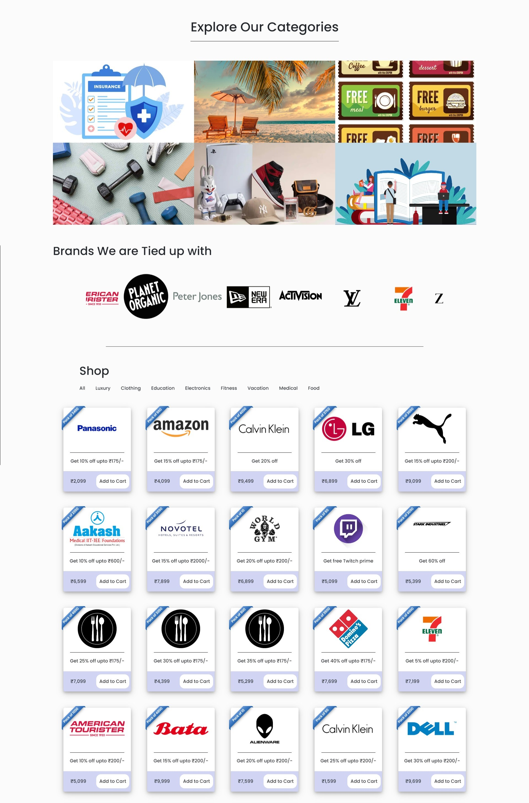
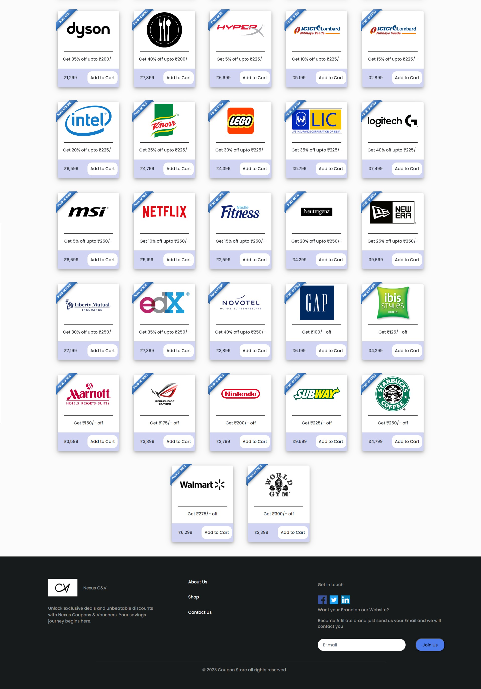

Slide 16
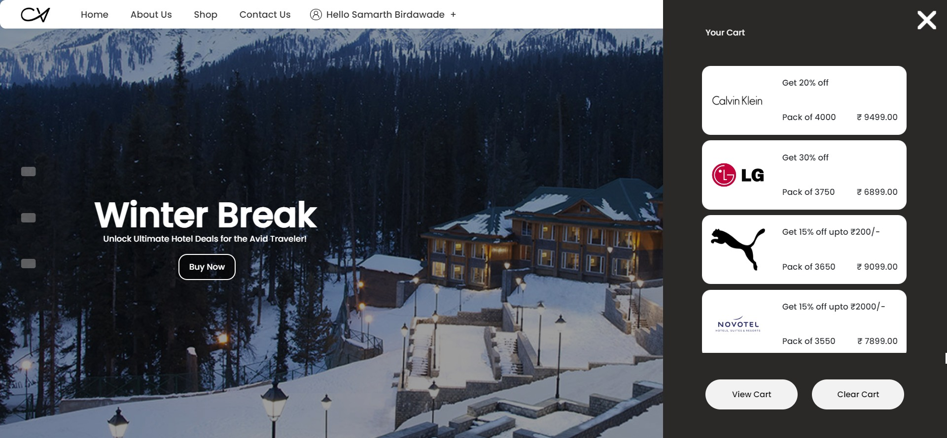

Slide 17
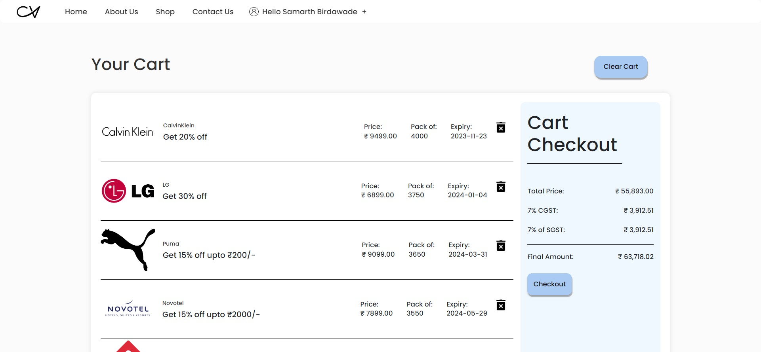

Slide 18
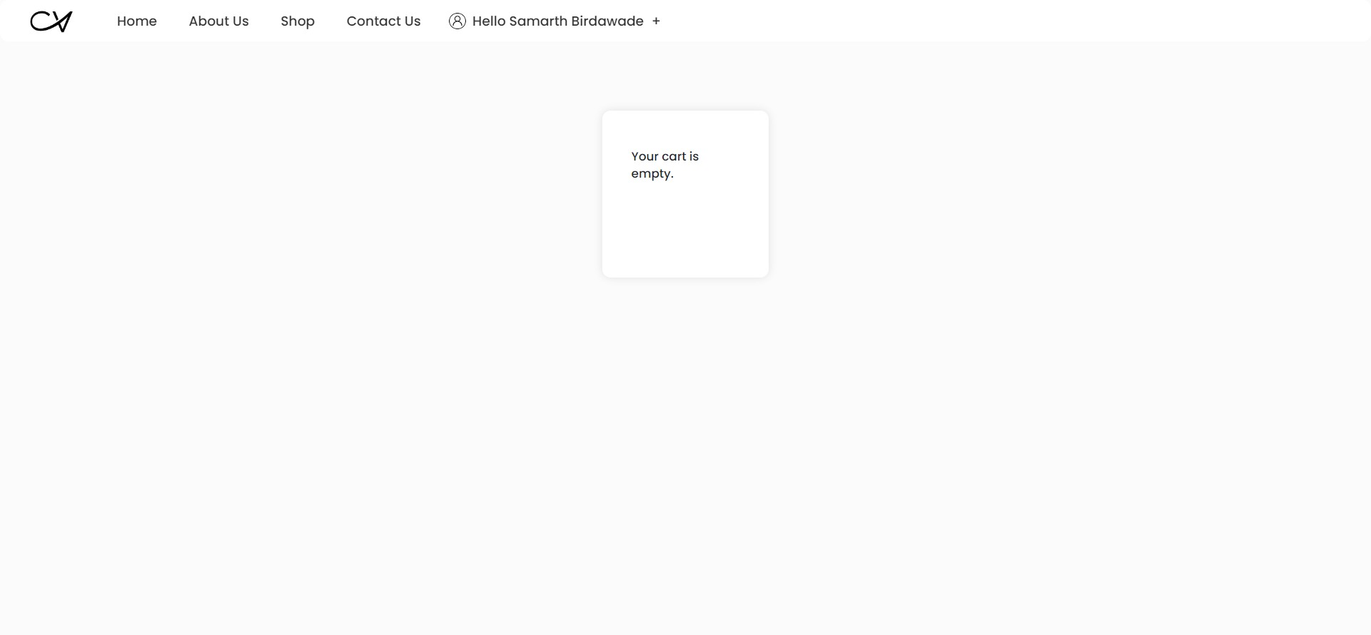

Slide 19
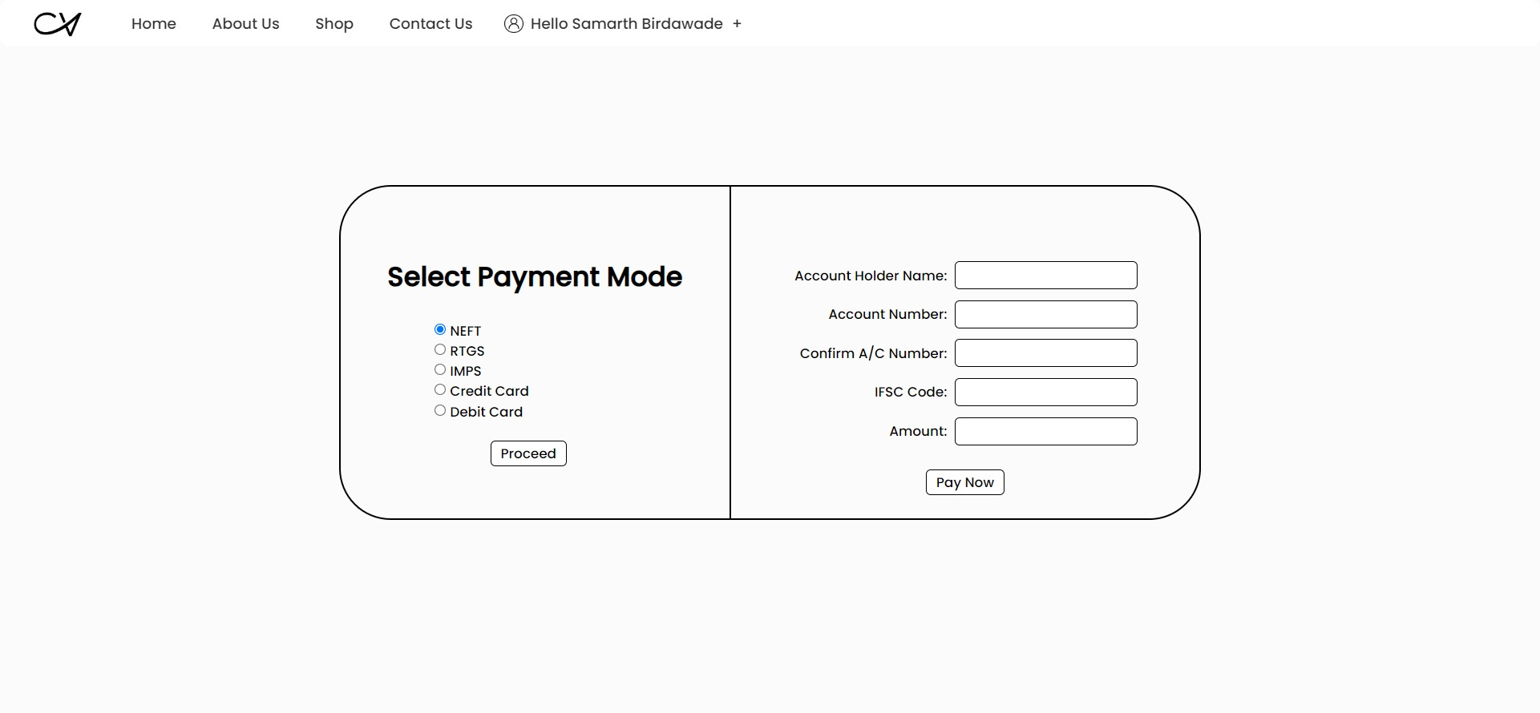

Slide 20
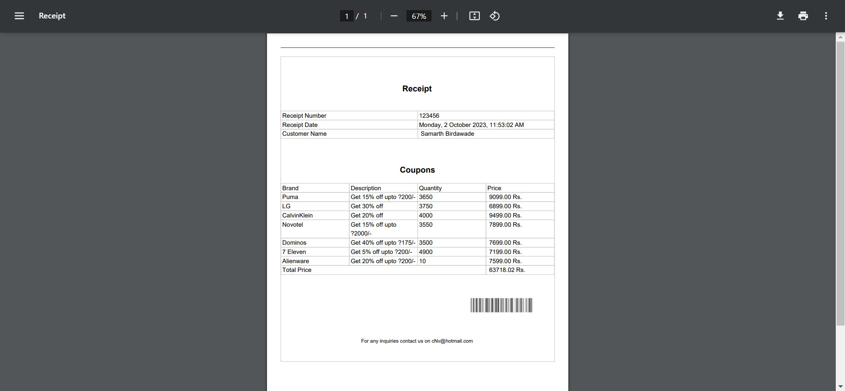

Slide 21
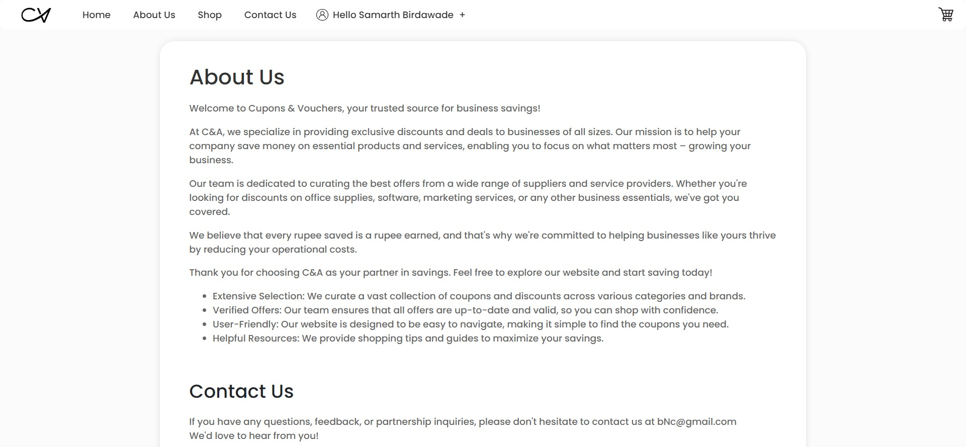
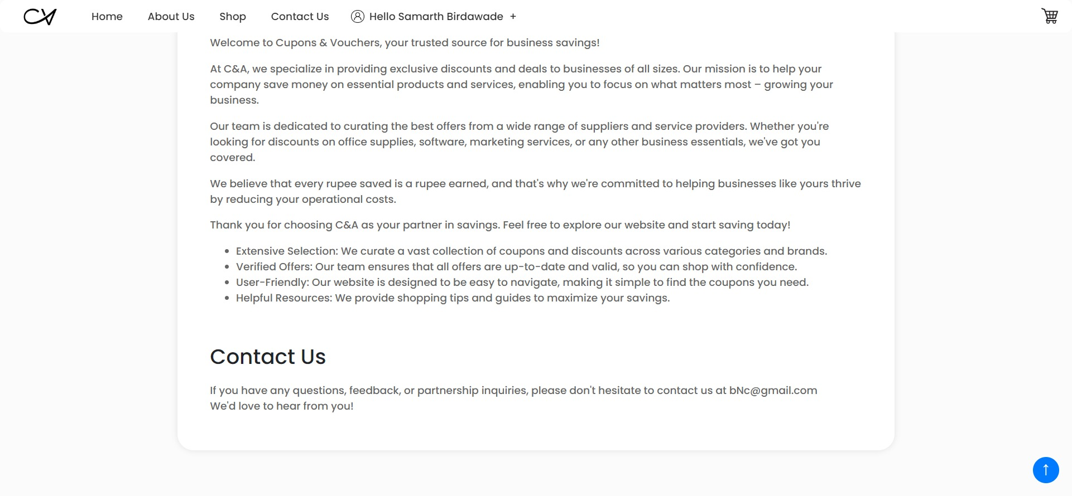

Slide 22
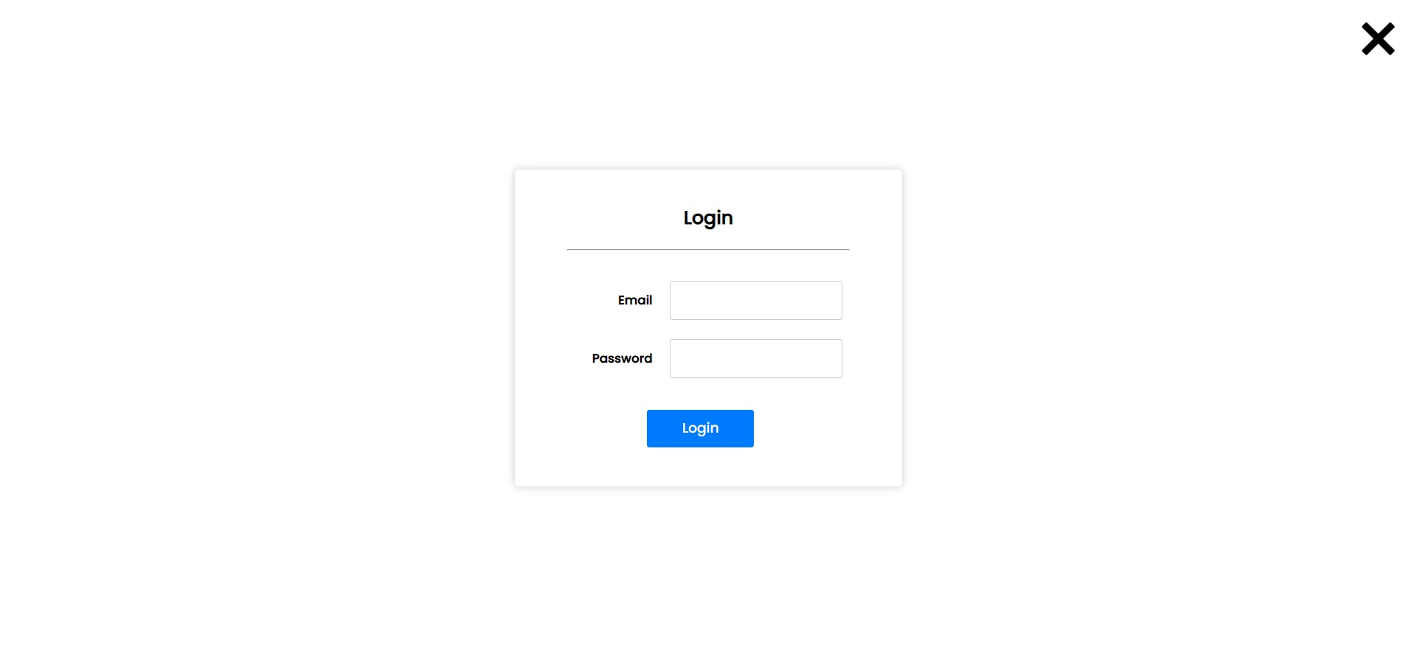
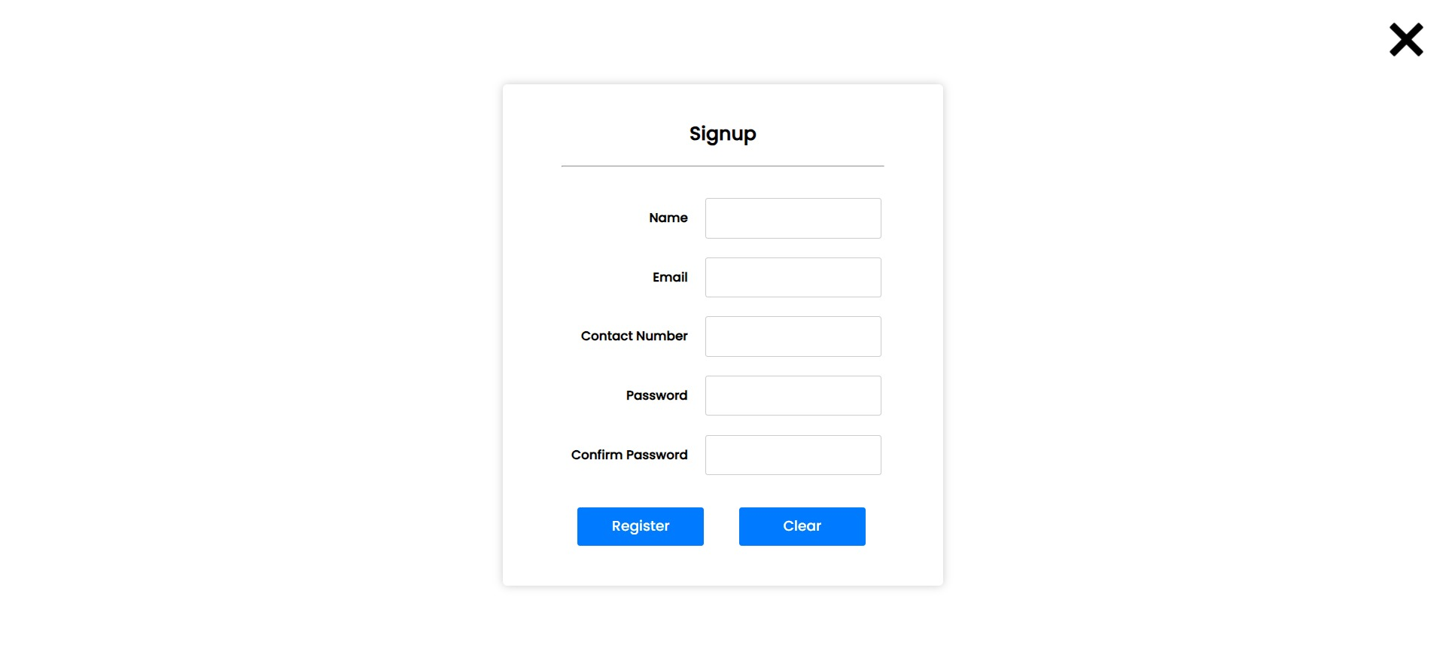

Slide 23
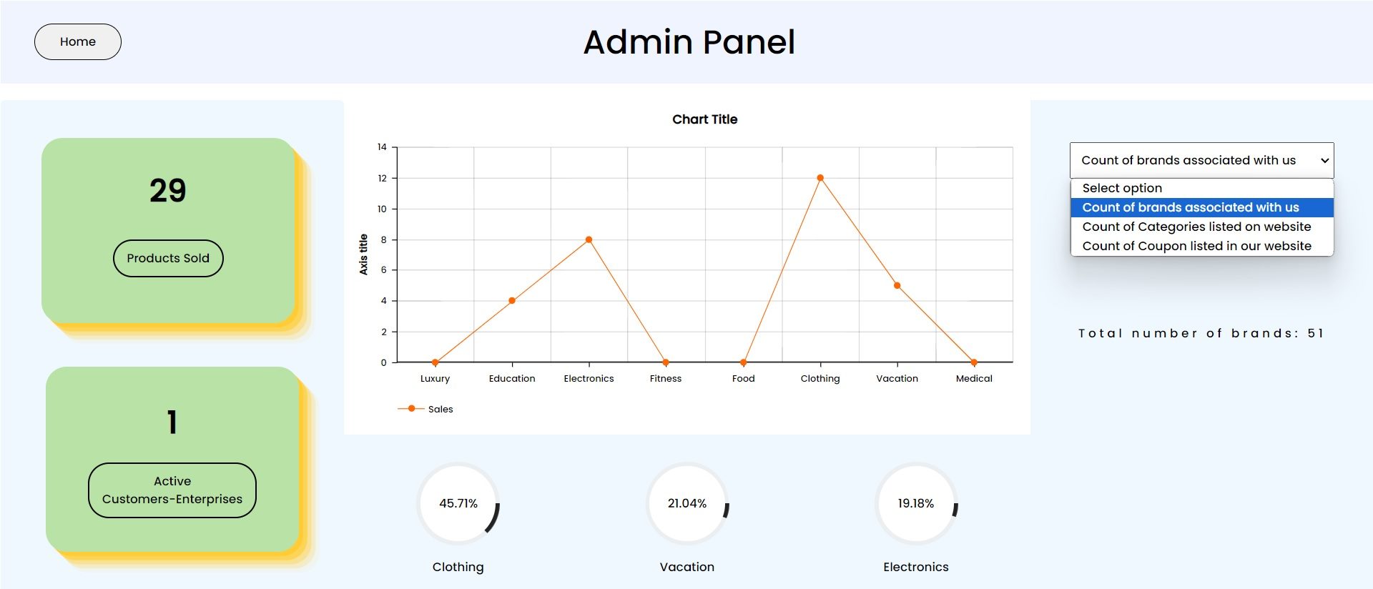

Slide 24
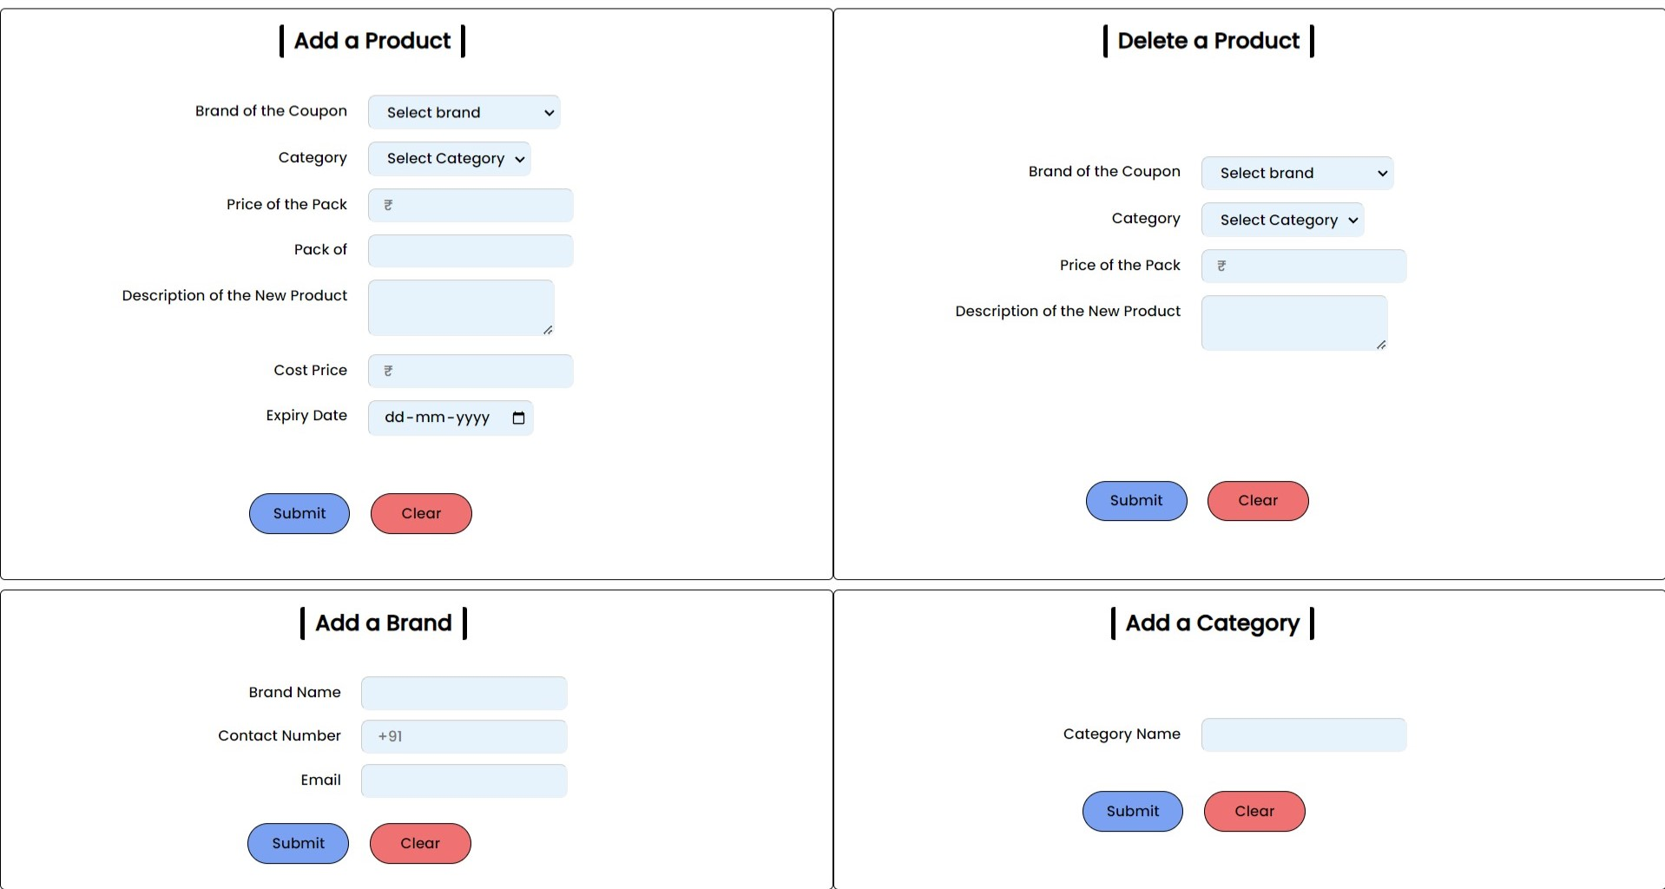

Slide 25
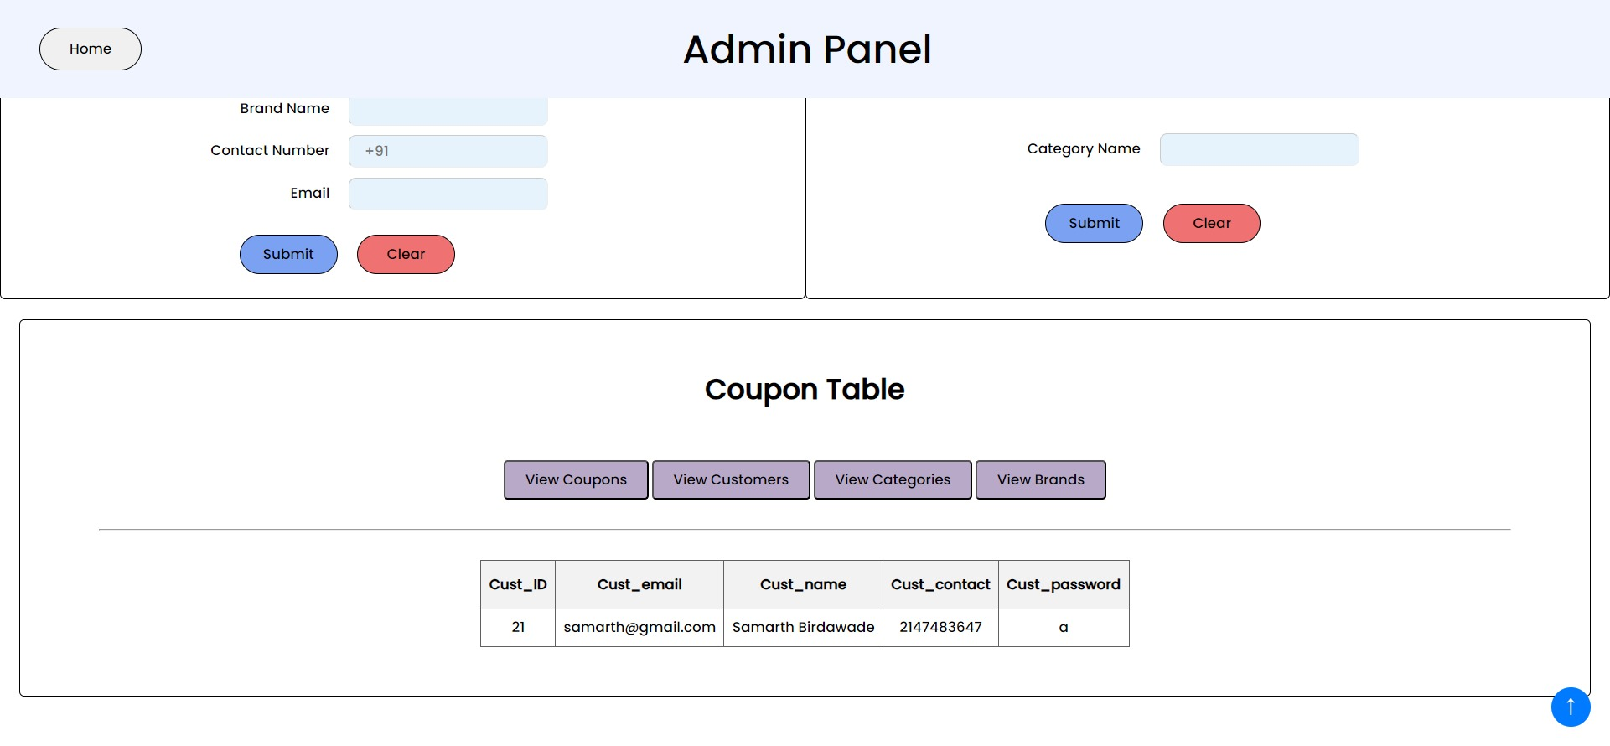

Slide 26
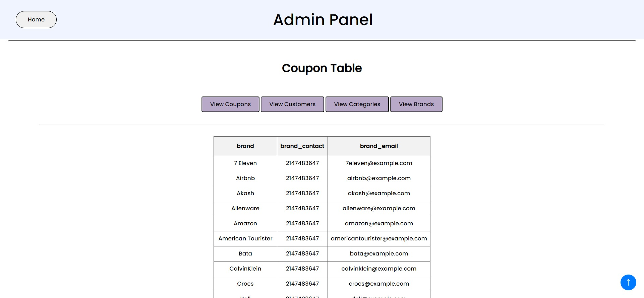

Slide 27


Meet our team
Pushkar Deepankar
Samarth Birdawade
Valued Member
Valued Member
27

Slide 28
Bibliography
https://www.
amcharts.com
https://www.
apachefriends.
org
https://codepen.io
https://chat.
openai.com
https://www.
google.com
28

Slide 29




Thank you
Nexus C&V
nexus@gmail.com
www.nexus.com

